Slide 1
JAVA SCRIPT VALIDATION

Slide 2
REGULAR EXPRESSION
A regular expression is a sequence of characters that forms a search pattern. The search pattern can be used for text search and text replace operations.
A regular expression can be a single character, or a more complicated pattern. Regular expressions can be used to perform all types of text search and text replace operations.

Slide 3
Regular Expression Modifiers
EXPRESSIONS | DESCRIPTION
[abc] | Find any of the character inside the brackets
[0-9] | Find any of the digits between the brackets 0 to 9
(x | y) | Find any of the alternatives between x or y separated with |

Slide 4
Regular Expression Patterns
QUANTIFIER | DESCRIPTION
n+ | Used to match any string that contains at least one n
n* | Used to match any string that ccontains zero or more occurrences of n
n? | Used to matches any string that contains zero or one occurrences of n

Slide 5
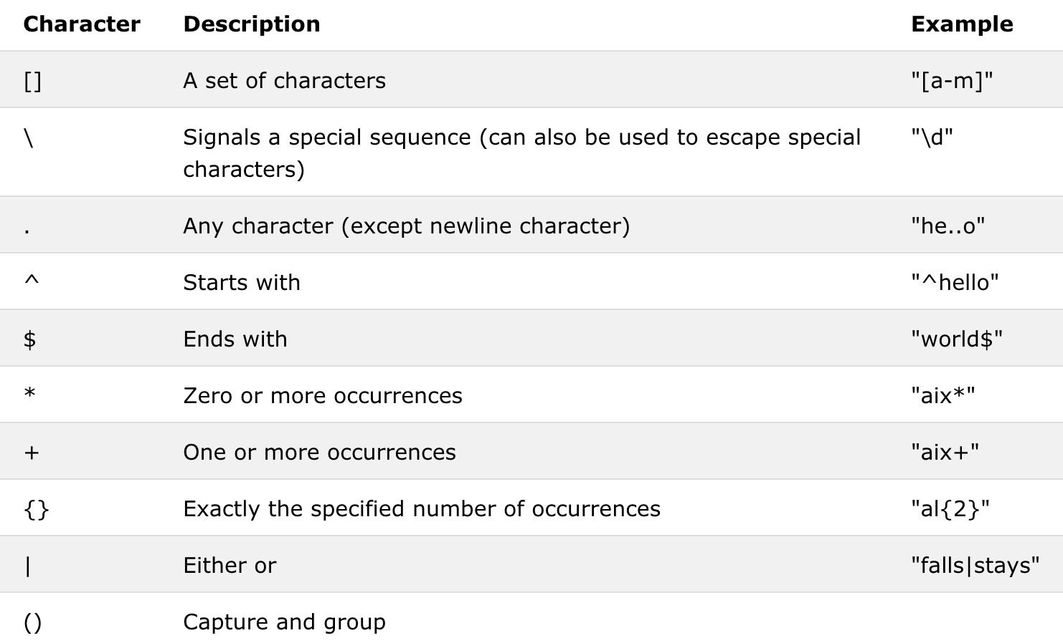

Slide 6
Expression | Description
[abc] | Find any character between the brackets
[^abc] | Find any character NOT between the brackets
[0-9] | Find any character between the brackets (any digit)
[^0-9] | Find any character NOT between the brackets (any non-digit)
(x|y) | Find any of the alternatives specified

Slide 7
Quantifier | Description
n+ | Matches any string that contains at least one n
n* | Matches any string that contains zero or more occurrences of n
n? | Matches any string that contains zero or one occurrences of n
n{X} | Matches any string that contains a sequence of X n's
n{X,Y} | Matches any string that contains a sequence of X to Y n's
n{X,} | Matches any string that contains a sequence of at least X n's
n$ | Matches any string with n at the end of it
^n | Matches any string with n at the beginning of it
?=n | Matches any string that is followed by a specific string n
?!n | Matches any string that is not followed by a specific string n
Metacharacter | Description
. | Find a single character, except newline or line terminator
\w | Find a word character
\W | Find a non-word character
\d | Find a digit
\D | Find a non-digit character
\s | Find a whitespace character
\S | Find a non-whitespace character
\b | Find a match at the beginning/end of a word, beginning like this: \bHI, end like this: HI\b
\B | Find a match, but not at the beginning/end of a word
\0 | Find a NUL character
\n | Find a new line character
\f | Find a form feed character
\r | Find a carriage return character
\t | Find a tab character
\v | Find a vertical tab character
\xxx | Find the character specified by an octal number xxx
\xdd | Find the character specified by a hexadecimal number dd
\udddd | Find the Unicode character specified by a hexadecimal number dddd

Slide 8
Email Id Validation
<form name="form1" action="#">
<ul>
<li><input type='text' name='text1'/></li>
<li class="submit">
<input type="submit" name="submit" value="Submit" onclick="ValidateEmail(document.form1.text1)"/>
</li>
</ul>
</form>
<script src="email-validation.js">
</script>
</body>
</html>

Slide 9
email-validation.js
function ValidateEmail(inputText)
{
var mailformat = /^\w+([\.-]?\w+)*@\w+([\.-]?\w+)*(\.\w{2,3})+$/; if(inputText.value.match(mailformat))
{
document.form1.text1.focus();
return true;
}
else
{
alert("You have entered an invalid email address!"); document.form1.text1.focus();
return false;
}
}

Slide 10
Email ID patterns
/^([a-zA-Z0-9_\.\-])+\@(([a-zA-Z0-9\-])+\.)+([a-zA-Z0-9]{2,4})+$/
/^([\w-\.]+)@((\[[0-9]{1,3}\.[0-9]{1,3}\.[0-9]{1,3}\.)|(([\w-]+\.)+))([a-zA-Z]{2,4}|[0-9]{1,3})(\]?)$/
/^\w+([-+.']\w+)*@\w+([-.]\w+)*\.\w+([-.]\w+)*$/
/^[_a-z0-9-]+(\.[_a-z0-9-]+)*@[a-z0-9-]+(\.[a-z0-9-]+)*(\.[a-z]{2,4})$/
/^[a-zA-Z0-9._-]+@[a-zA-Z0-9.-]+\.[a-zA-Z]{2,4}$/

Slide 11
<html ><head >
<script type="text/javascript">
function IsValidEmail(email) {
var expr = /^([\w-\.]+)@((\[[0-9]{1,3}\.[0-9]{1,3}\.[0-9]{1,3}\.)|(([\w-]+\.)+))([a-zA-Z]{2,4}|[0-9]{1,3})(\]?)$/;
return expr.test(email);
};
function ValidateEmail() {
var email = document.getElementById("txtEmail").value;
if (!IsValidEmail(email)) {
alert("Invalid email address.");
}
else {
alert("Valid email address.");
}
}
</script></head>
<body>
<form id="form1">
<input type="text" id="txtEmail" />
<input type="button" id="btnValidate" value="ValidateEmail"
onclick = "ValidateEmail()" />
</form></body></html>

Slide 12
Mobile Number Validation
function phonenumber(inputtxt)
{
var phoneno = /^\d{10}$/; if((inputtxt.value.match(phoneno))
{
return true;
}
else
{
alert("message");
return false;
}
}

Slide 13
Validating Mobile Number using length
<html><body>
<input id="numb">
<button type="button" onclick="myFunction()">Submit</button>
<p id="demo"></p>
<script>
function myFunction() {
var x = document.getElementById("numb").value;
var text;
if (isNaN(x) || x < 1 || x > 10) {
text = "Input not valid";
} else {
text = "Input OK";
}
document.getElementById("demo").innerHTML = text;
}
</script></body></html>

Slide 14
Validating Mobile Number using Regular Expression
<script type="text/javascript">
function validate() {
var user = document.getElementById("c").value;
var user2 = document.getElementById("c");
var re = /^[7-9][0-9]{9}$/;
if (re.test(user)) {
alert("done");
return true;
}
else {
user2.style.border = "red solid 3px";
return false;
}
}
</script>
</head>

Slide 15
Mobile Number Patterns
/^\(?([0-9]{3})\)?[-. ]?([0-9]{3})[-. ]?([0-9]{4})$/
/^([0|\+[0-9]{1,5})?([7-9][0-9]{9})$/
/^[1-9]\d{9}$/

Slide 16
VALIDATION WITHOUT REGULAR EXPRESSION
<script>
function validateform(){
var name=document.myform.name.value;
var password=document.myform.password.value;
if (name==null || name==""){
alert("Name can't be blank");
return false;
}else if(password.length<6){
alert("Password must be at least 6 characters long.");
return false;
}
}
</script>
<body>
<form name="myform" method="post" action="abc.jsp" onsubmit="return validateform()" > Name: <input type="text" name="name"><br/>
Password: <input type="password" name="password"><br/>
<input type="submit" value="register">
</form>

Slide 17
JavaScript Retype Password Validation
<script type="text/javascript">
function matchpass( ){
var firstpassword=document.f1.password.value;
var secondpassword=document.f1.password2.value;
if(firstpassword==secondpassword){
return true;
}
else{
alert("password must be same!");
return false;
}
}
</script>
<form name="f1" action="register.jsp" onsubmit="return matchpass( )">
Password:<input type="password" name="password" /><br/>
Re-enter Password:<input type="password" name="password2"/><br/>
<input type="submit"></form>

Slide 18
JavaScript Number Validation
<script>
function validate(){
var num=document.myform.num.value;
if (isNaN(num)){
document.getElementById("numloc").innerHTML="Enter Numeric value only";
return false;
}else{
return true;
}
}
</script>
<form name="myform" onsubmit="return validate()" >
Number: <input type="text" name="num"><span id="numloc"></span><br/>
<input type="submit" value="submit">
</form>

Slide 19
JavaScript email validation
<script>
function validateemail()
{
var x=document.myform.email.value;
var atposition=x.indexOf("@");
var dotposition=x.lastIndexOf(".");
if (atposition<1 || dotposition<atposition+2 || dotposition+2>=x.length){
alert("Please enter a valid e-mail address \n atpostion:"+atposition+"\n dotposition:"+dotposition);
return false;
}
}
</script>
<body>
<form name="myform" method="post" action="#" onsubmit="return validateemail();">
Email: <input type="text" name="email"><br/>
<input type="submit" value="register">
</form>

Slide 20
MULTIMEDIA

Slide 21
What is Multimedia?
Multimedia on the web, is sound, music, videos, movies, and animations.
Multimedia comes in many different formats. It can be almost anything you can hear or see.
Examples: Pictures, music, sound, videos, records, films, animations, and more.
Web pages often contains multimedia elements of different types and formats.
Multimedia Formats
Multimedia files also have their own formats and different extensions like: .swf, .wav, .mp3, .mp4, .mpg, .wmv, and .avi.
MP3 is the newest format for compressed recorded music.

Slide 22
Including Video file
<html>
<body>
<video width="400" controls>
<source src="a.mp4" type="video/mp4">
</video>
<p> Video </p>
</body>
</html>

Slide 23
Auto Play
<html>
<body>
<video width="320" height="240" autoplay>
<source src=“a.mp4" type="video/mp4">
<source src=“a.ogg" type="video/ogg">
</video>
</body>
</html>

Slide 24
<html> <body>
<div style="text-align:center">
<button onclick="playPause( )">Play/Pause</button>
<button onclick="makeBig( )">Big</button>
<button onclick="makeSmall( )">Small</button>
<button onclick="makeNormal( )">Normal</button><br>
<video id="video1" width="420">
<source src=“a.mp4" type="video/mp4">
</video></div>
<script>
var myVideo = document.getElementById("video1");
function playPause( ) {
if (myVideo.paused)
myVideo.play( );
else
myVideo.pause( ); }
function makeBig( ) { myVideo.width = 560; }
function makeSmall( ) { myVideo.width = 320; }
function makeNormal( ) { myVideo.width = 420;
} </script> </body> </html>

Slide 25
Audio on the Web
To play an audio file in HTML, use the <audio> element.
The controls attribute adds audio controls, like play, pause, and volume.
Text between the <audio> and </audio> tags will display in browsers that do not support the <audio> element.
Multiple <source> elements can link to different audio files. The browser will use the first recognized format.
Example:
<html>
<body>
<audio controls>
<source src="Sleep Away.mp3" type="audio/mpeg">
</audio>
</body>
</html>

Slide 26
JavaScript Events

Slide 27
Mouse events:
Event Performed | Event Handler | Description
click | onclick | When mouse click on an element
mouseover | onmouseover | When the cursor of the mouse comes over the element
mouseout | onmouseout | When the cursor of the mouse leaves an element
mousedown | onmousedown | When the mouse button is pressed over the element
mouseup | onmouseup | When the mouse button is released over the element
mousemove | onmousemove | When the mouse movement takes place.

Slide 28
Form events:
Event Performed | Event Handler | Description
focus | onfocus | When the user focuses on an element
submit | onsubmit | When the user submits the form
blur | onblur | When the focus is away from a form element
change | onchange | When the user modifies or changes the value of a form element

Slide 29
Window/Document events
Event Performed | Event Handler | Description
load | onload | When the browser finishes the loading of the page
unload | onunload | When the visitor leaves the current webpage, the browser unloads it
resize | onresize | When the visitor resizes the window of the browser

Slide 30
Example for onclick( )
<html>
<head> Javascript Events </head>
<body>
<script language="Javascript" type="text/Javascript">
function clickevent( )
{
document.write("This is I MCA");
}
</script>
<form>
<input type="button" onclick="clickevent( )" value="Who's this?"/>
</form>
</body> </html>

Slide 31
Focus Event
<html>
<head> Javascript Events</head>
<body>
<h2> Enter something here</h2>
<input type="text" id="input1" onfocus="focusevent()"/>
<script>
function focusevent()
{
document.getElementById("input1").style.background=" aqua";
}
</script>
</body>
</html>

Slide 32
JavaScript eval( ) function
The eval( ) function in JavaScript is used to evaluate the expression.
<html> <head>
<script>
var a = 10, b = 20, c = 30, sum, mul, sub;
sum = eval(" a + b + c ");
mul = eval(" a * b * c");
sub = eval(" a - b");
document.write(sum + "<br>");
document.write(mul + "<br>");
document.write(sub);
</script>
</head> </html>

